Slide 1



Understanding drivers of primate movements in fragments: insights from an agent-based modelling simulation
Eco Mod Seminar Presentation
Eduardo Miguel Zanette
Ecology, Evolution and Biodiversity Graduate Program
Master’s student – Laboratory of Primatology
UNESP - São Paulo State University
Advisor: Laurence Culot
Co-advisor: Ronald Bialozyt
2022-05-12d

Slide 2
INDEX
INTRODUCTION
AIMS
MODEL DEVELOPMENT
MODEL VALIDATION
SCENARIO SIMULATION
OUTLOOK (NEXT STEPS)

Slide 3
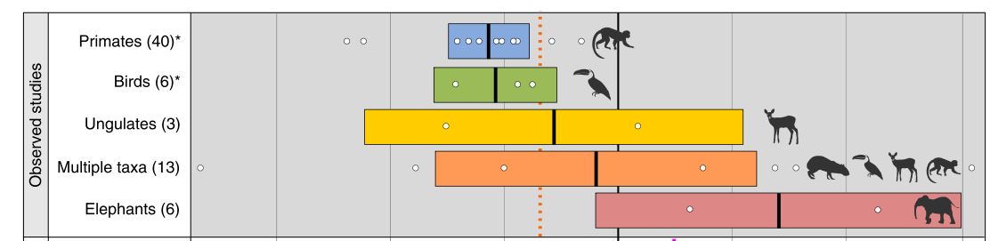
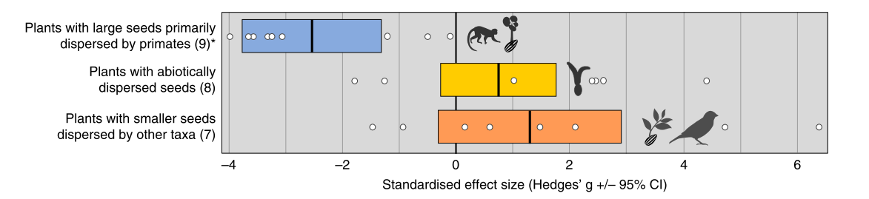
1) INTRODUCTION
Primates are importante seed dispersers
Mainly by endozoochory
What make them so importante nad effective to tropical forest dynamics?
Fig. 1 Defaunation effect on forest regeneration by taxonomic group
Fig. 2 Defaunation effect on forest regeneration by disperal syndrome
Gardner et al 2019

Slide 4
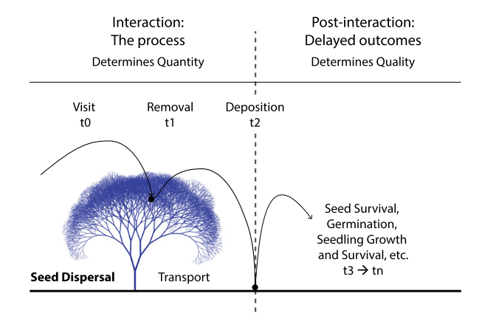
1) INTRODUCTION
Primates are importante seed dispersers
Mainly by endozoochory
What make them so importante nad effective to tropical forest dynamics?
Fig. 3 Seed Dispersal Effectivenes
Schupp et al. 2017 Ecol. Lett.

Slide 5
1) INTRODUCTION
Seed shadow:
Spatially explicit result of seed dispersal (Nathan et al. 2012)
- Linked to density-dependent processes (competition, predation) (Comita et al. 2014)
Seed Dispersal Distance (SDD) as proxy for SDE
Fig. 3 Seed Dispersal Effectivenes
Schupp et al. 2017 Ecol. Lett.

Slide 6
1) INTRODUCTION
Seed shadow:
Spatially explicit result of seed dispersal (Nathan et al. 2012)
- Linked to density-dependent processes (competition, predation) (Comita et al. 2014)
Seed Dispersal Distance (SDD) as proxy for SDE
- Other effects on the post dispersal phase (e.g. germination, Fuzessy et al. 2016)
Movement patterns as one of the main factors making primates importante seed dispersers
Fig. 3 Seed Dispersal Effectivenes
Schupp et al. 2017 Ecol. Lett.

Slide 7
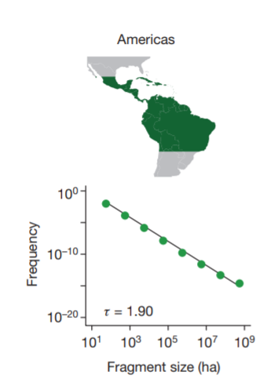
1) INTRODUCTION
Forest fragmentation and loss on tropical forests...
Fig. 4 Distribution of fragmente sizes in the Neotropical Region
Taubert et al. 2018 Nature

Slide 8
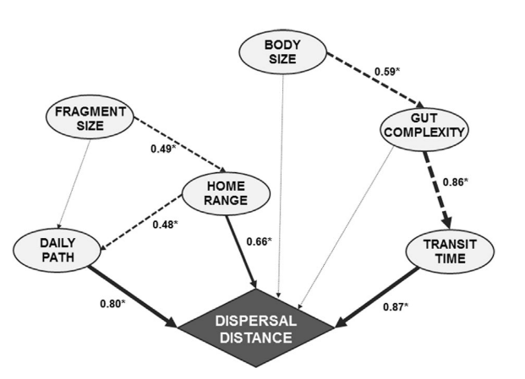
1) INTRODUCTION
Forest fragmentation and loss on tropical forests...
... And its results on the patterns of movement and seed dispersal by primates
Fig. 4 Distribution of fragmente sizes in the Neotropical Region
Fig. 5 Factors influencing the Seed Dispersal Distance (SDD) on primates
Taubert et al. 2018 Nature
Fuzessy et al. 2017 AJP

Slide 9
1) INTRODUCTION
Forest fragmentation and loss on tropical forests...
... And its results on the patterns of movment and seed dispersal by primates
Effect of local forest patch on the movement patternss and therefore on SDD
Fig. 4 Distribution of fragmente sizes in the Neotropical Region
Fig. 5 Factors influencing the Seed Dispersal Distance (SDD) on primates
Taubert et al. 2018 Nature
Fuzessy et al. 2017 AJP

Slide 10
1) INTRODUCTION
What are the effects of forest patch size and shape on primate movement patterns?

Slide 11
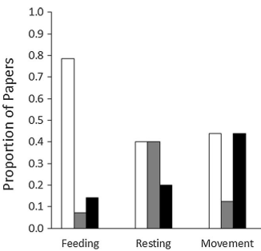
1) INTRODUCTION
What are the effects of forest patch size and shape on primate movement patterns?
Inconsistent effect
No relation to species attributes (dispersal capacity, home range size, diet specialization, etc)
Modified from Carretero-Pinzón et al. (2016)

Slide 12
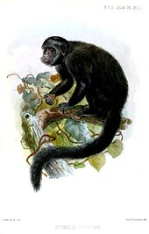
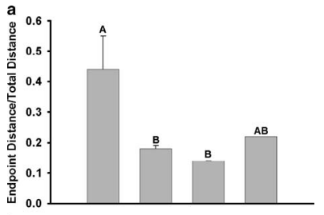

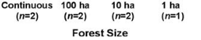
1) INTRODUCTION
What are the effects of forest patch size and shape on primate movement patterns?
1 = linear patterns
0 = circular patterns
*No work testing the effect of patch shape on primate movements
Inconsistent effect
No relation to species attributes (dispersal capacity, home range size, diet specialization, etc)
Tendency towards circular movements in smaller fragments (Chiropotes satanas)
Modified from Carretero-Pinzón et al. (2016)
Modified from Boyle et al. (2009)

Slide 13
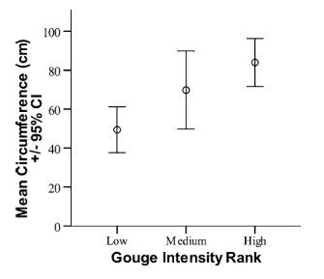
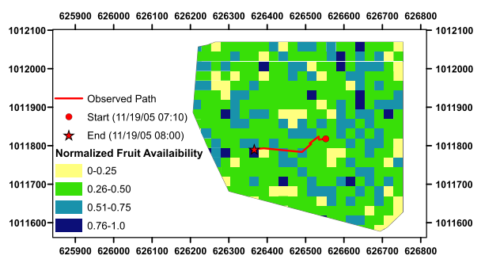
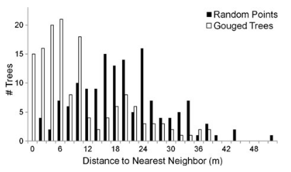
1) INTRODUCTION
What is the effects of resource distribution on primate movement patterns?
Limited evidence of environmental factors affecting primate movements and seed dispersal
Costly and intensive labor for sampling; replication problems
Agent based models are good candidates for addressing the effects of fragmentation on these processes
Alouatta palliata aims for close places with higher fruit availbility (estimated by tree DBH)
Larger trees (high DBH) are more intensily gouged
Gouging trees more agreggated than expected by chance
13
Thompson et al. (2013) IJP
Hopkins (2016) Anim. Cog.

Slide 14
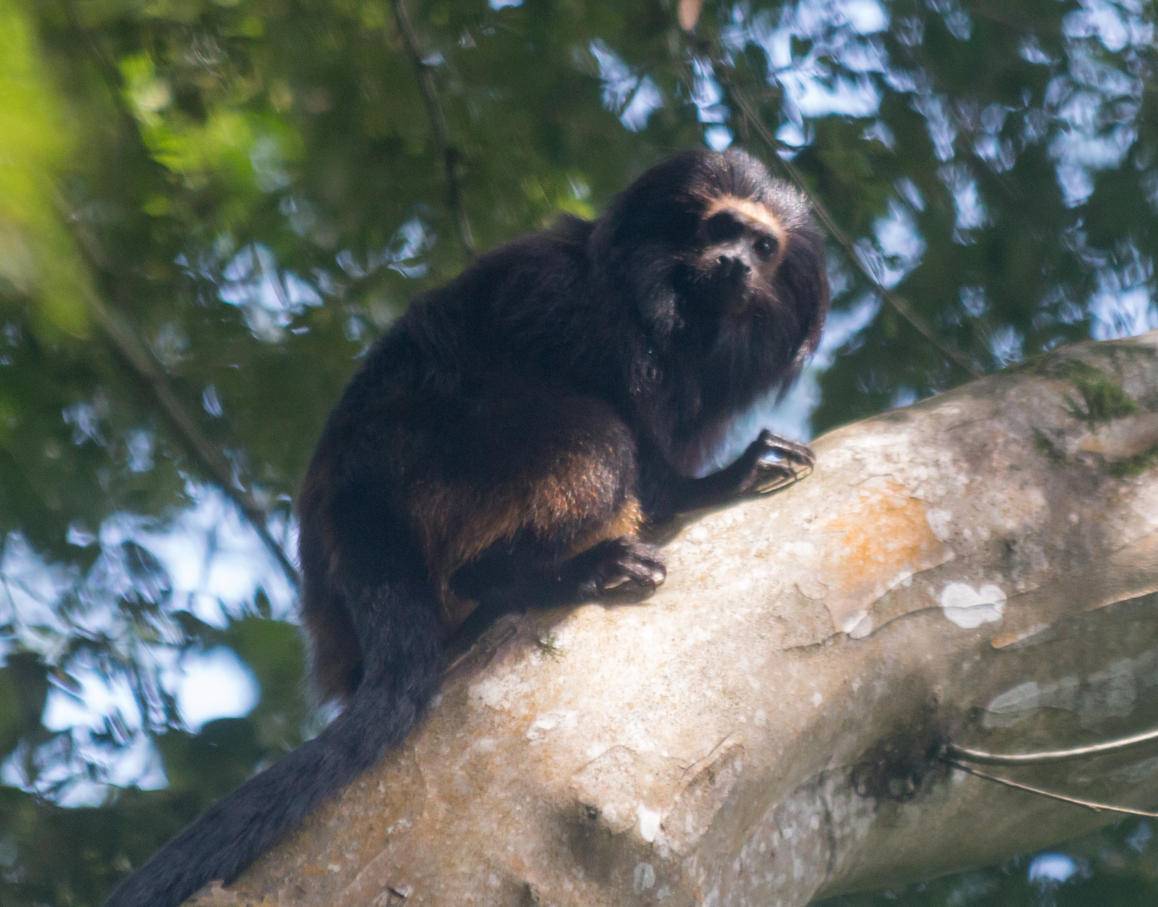


1) INTRODUCTION
others
Diet
Black lion tamarin
(Leontopithecus chrysopygus)
Frugivore-insectivore, small, territorial
Inhabits small, riparian and continuous forests Daily Path Lenght: 1000 ~ 4000 m
Home range size: 25 ~ 400 ha Effectively disperses seeds of trees and lianas

Slide 15
1) INTRODUCTION
others
Diet
Black lion tamarin
(Leontopithecus chrysopygus)
Home range (Burt, 1943):
“[...] that area traversed by the individual in its normal activities of food gathering, mating and caring for young.”
Frugivore-insectivore, small, territorial
Inhabits small, riparian and continuous forests Daily Path Lenght: 1000 ~ 4000 m
Home range size: 25 ~ 400 ha Effectively disperses seeds of trees and lianas

Slide 16
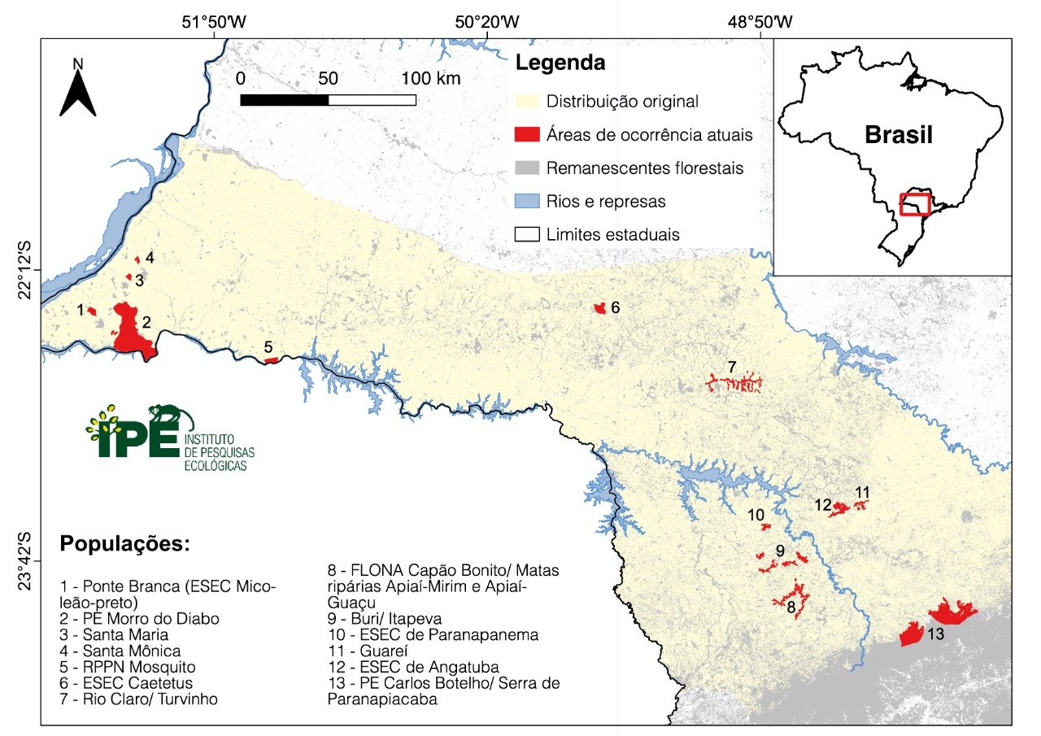
1) INTRODUCTION
others
Diet
Black lion tamarin
(Leontopithecus chrysopygus)
Frugivore-insectivore, small, territorial
Inhabits small, riparian and continuous forests Daily Path Lenght: 1000 ~ 4000 m
Home range size: 25 ~ 400 ha Effectively disperses seeds of trees and lianas
- Continuous forest patches (32000 ha), small (100 a >1000 ha) and riparian
- Variation on movement and resource utilization

Slide 17

1) INTRODUCTION
others
Diet
Black lion tamarin
(Leontopithecus chrysopygus)
Home range size correlated to forest patch size:
(Pearson ρ = [0.7, 0.9], p < 0.0001) (Rezende, G. unpublished)
Frugivore-insectivore, small, territorial
Inhabits forests with varying sizes and shapes Daily Path Lenght: 1000 ~ 4000 m
Home range size: 25 ~ 400 há Effectively disperses seeds of trees and lianas
- Continuous forest patches (32000 ha), small (100 a >1000 ha) and riparian
- Variation on movement and resource utilization
17

Slide 18




1) INTRODUCTION
others
Diet
SDD
seed removal
seed dispersal (endozoochory)
Black lion tamarin
(Leontopithecus chrysopygus)
Home range size correlated to forest patch size:
(Pearson ρ = [0.7, 0.9], p < 0.0001) (Rezende, G. unpublished)
Frugivore-insectivore, small, territorial
Inhabits forests with varying sizes and shapes Daily Path Lenght: 1000 ~ 4000 m
Home range size: 25 ~ 400 há Effectively disperses seeds of trees and lianas
How diferent forest sizes and shapes and resource distributions affect BLT movement patterns and therefore its seed shadows?
- Continuous forest patches (32000 ha), small (100 a >1000 ha) and riparian
- Variation on movement and resource utilization
18

Slide 19
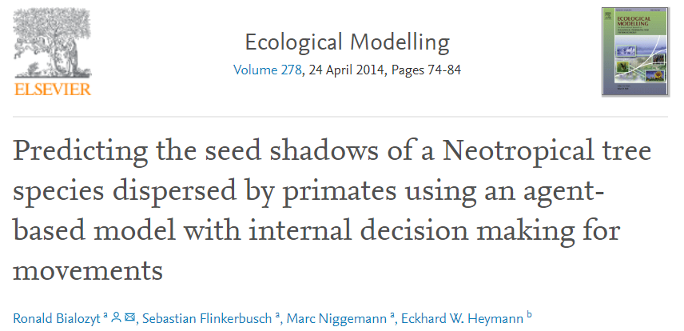
1) INTRODUCTION
others
Diet
SDD
seed removal
seed dispersal (endozoochory)
Black lion tamarin
(Leontopithecus chrysopygus)
Home range size correlated to forest patch size:
(Pearson ρ = [0.7, 0.9], p < 0.0001) (Rezende, G. unpublished)
Frugivore-insectivore, small, territorial
Inhabits forests with varying sizes and shapes Daily Path Lenght: 1000 ~ 4000 m
Home range size: 25 ~ 400 há Effectively disperses seeds of trees and lianas
How diferent forest sizes and shapes and resource distributions affect BLT movement patterns and therefore its seed shadows?
- Continuous forest patches (32000 ha), small (100 a >1000 ha) and riparian
- Variation on movement and resource utilization
19

Slide 20
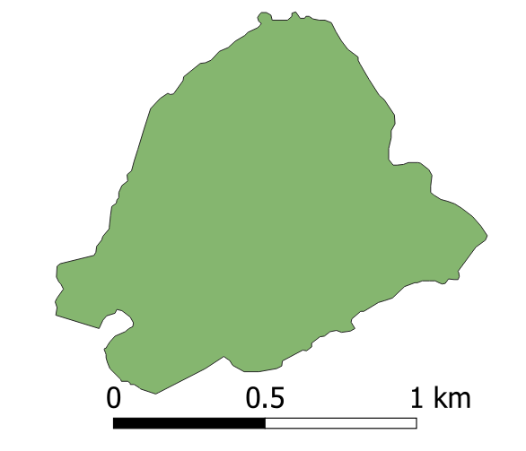
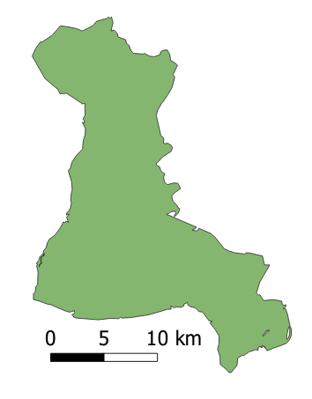
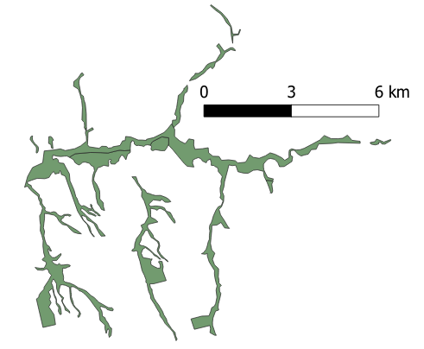
2) AIMS
1
Validate ABM for 3 areas
Small patch
(100 ha) - Guareí
Home range:
~48 ha
Continuous forest
Taquara (PEMD)
Home range:
~400 ha
Riparian forest
Suzano
Home range:
~25 ha

Slide 21
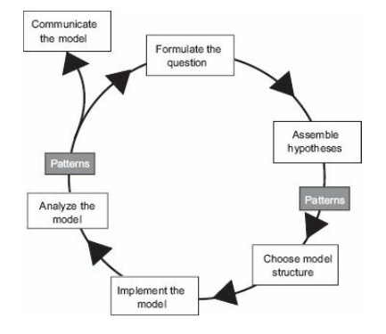
2) AIMS
1
Validate ABM for 3 areas
Small patch
(100 ha) - Guareí
Home range:
~48 ha
Continuous forest
Taquara (PEMD)
Home range:
~400 ha
Riparian forest
Suzano
Home range:
~25 ha
Fig. 6 POM (“Modelling cycle”) Grimm & Raillsback 2005

Slide 22
2) AIMS
Multi pattern validation:
1) Home range size
2) Daily Path Length (DPL)
3) Activity Budget
4) Seed Dispersal Distance (SDD)
1
Validate ABM for 3 areas
Small patch
(100 ha) - Guareí
Home range:
~48 ha
Continuous forest
Implementation hypothesis:
1) Step length + turning angles
2) Resource distributions
3) Territoriality
Taquara (PEMD)
Home range:
~400 ha
Riparian forest
Suzano
Home range:
~25 ha
Fig. 6 POM (“Modelling cycle”) Grimm & Raillsback 2005

Slide 23
2) AIMS
Multi pattern validation:
1) Home range size
2) Daily Path Length (DPL)
3) Activity Budget
4) Seed Dispersal Distance (SDD)
1
Validate ABM for 3 areas
Small patch
(100 ha) - Guareí
TRACE Documentation (reproducibility)
nrlx package (Salecker et al. 2019)
Validation: comparisons between means/distributions of three areas
Home range:
~48 ha
Continuous forest
Implementation hypothesis:
1) Step length + turning angles
2) Resource distributions
3) Territoriality
Taquara (PEMD)
Home range:
~400 ha
Riparian forest
Suzano
Home range:
~25 ha
Fig. 12 POM (“Modelling cycle”) Grimm & Raillsback 2005

Slide 24
2) AIMS
2
Scenario simulations
Test the effect of:
Patch size
Patch shape
Resource agregation
Virtual fragments (“environmental contexts”)

Slide 25
2) AIMS
2
Scenario simulations
Test the effect of:
Patch size
Patch shape
Resource agregation
Virtual fragments (“environmental contexts”)
(Focus on Model validtion)

Slide 26
3) MODEL DEVELOPMENT

Slide 27
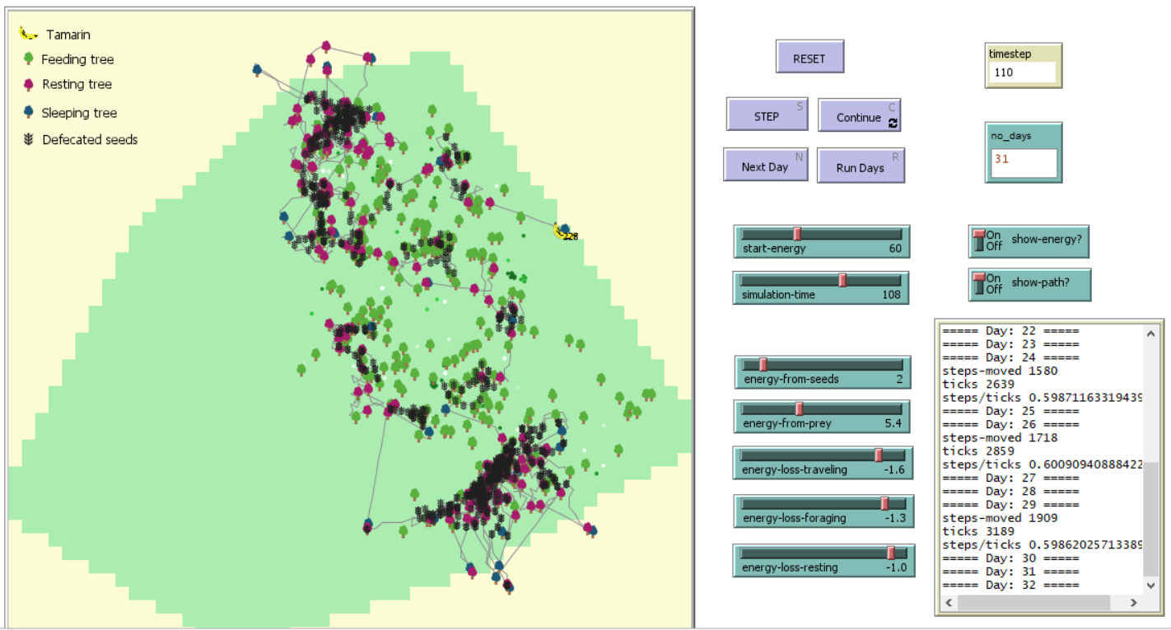
3) MODEL DEVELOPMENT
Mayara & Ronald ABM (2020)
27

Slide 28
3) MODEL DEVELOPMENT
Mayara & Ronald ABM (2020)
1) Home range ✓
2) DPL x
3) SDD x
4) Activity Budget x
28

Slide 29
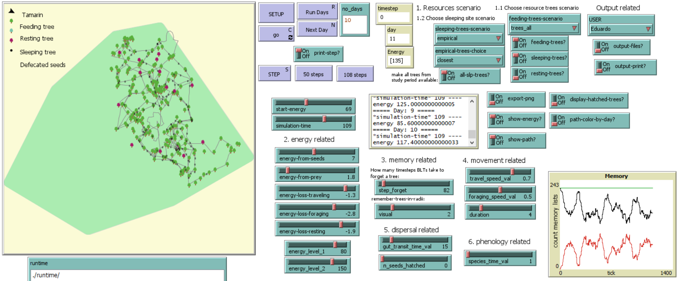
3) MODEL DEVELOPMENT
Model v1 2022
29

Slide 30
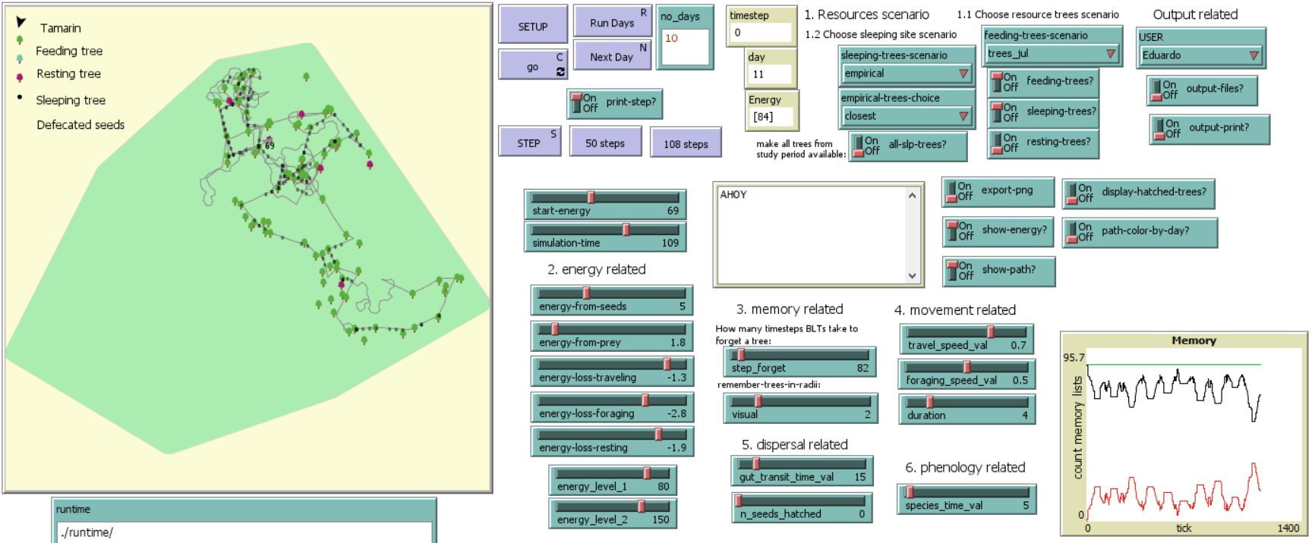
3) MODEL DEVELOPMENT
Model v1 2022
30

Slide 31
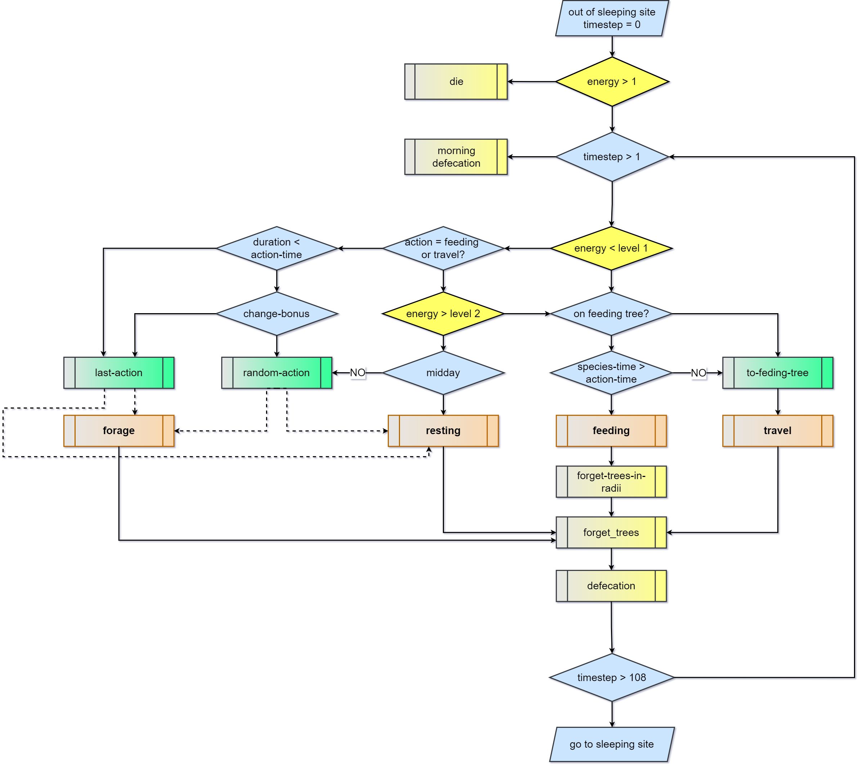
3) MODEL DEVELOPMENT
Model v1 2022: Flowchart
31

Slide 32
3) MODEL DEVELOPMENT
Model v1 2022: Flowchart
32

Slide 33
3) MODEL DEVELOPMENT
Model v1 2022: Flowchart
33

Slide 34
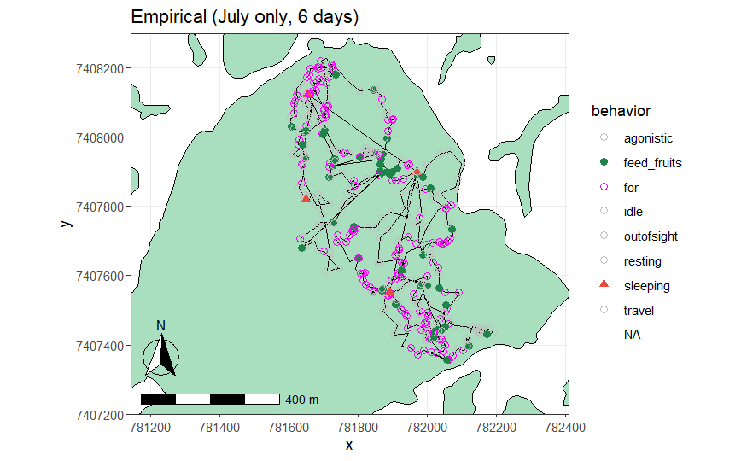
4) MODEL VALIDATION
Model v1 2022:
Sample runs

Slide 35
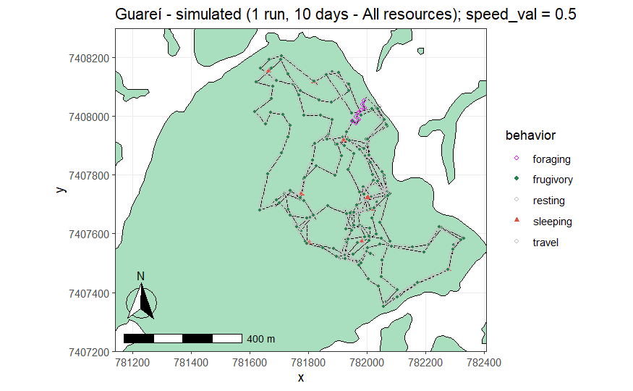
4) MODEL VALIDATION
Model v1 2022:
Sample runs

Slide 36
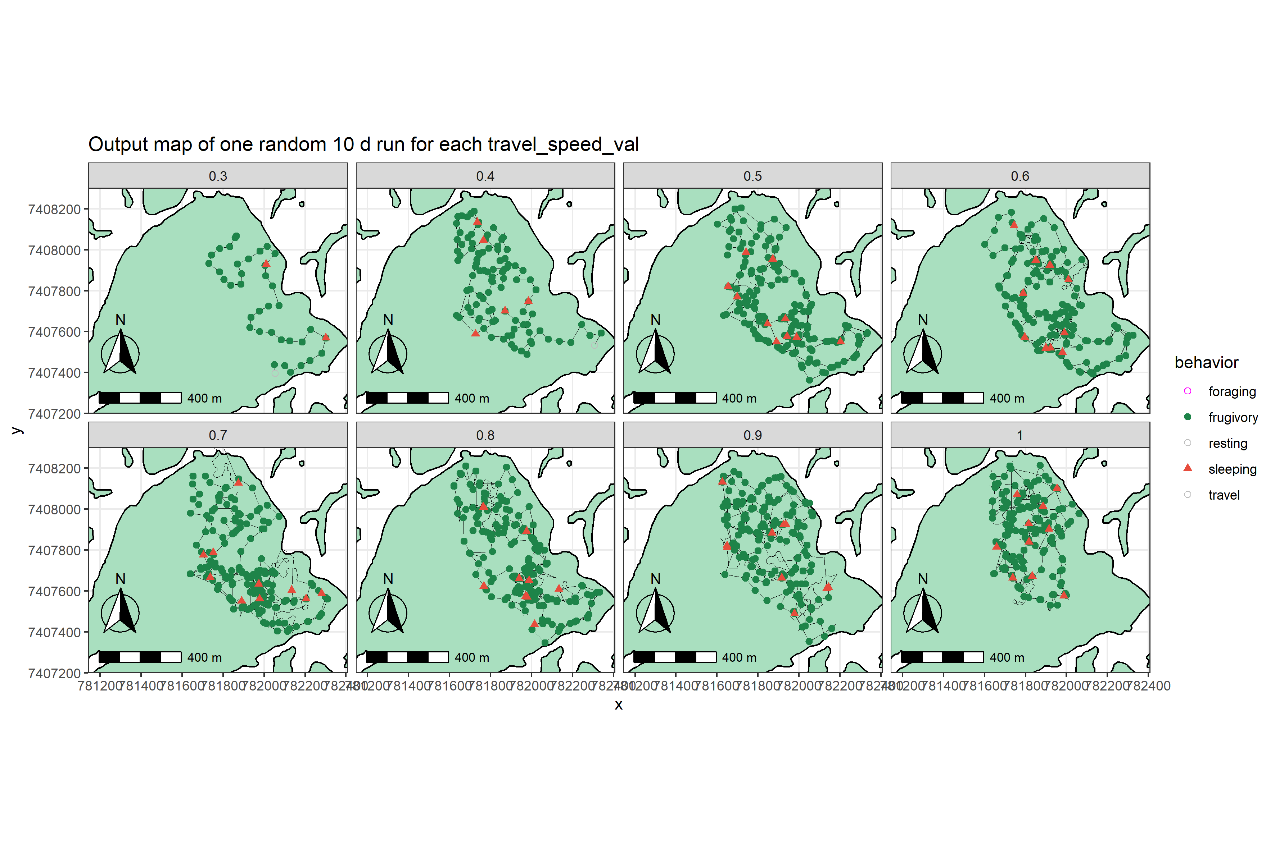
4) MODEL VALIDATION
Model v1 2022:
Sample runs

Slide 37
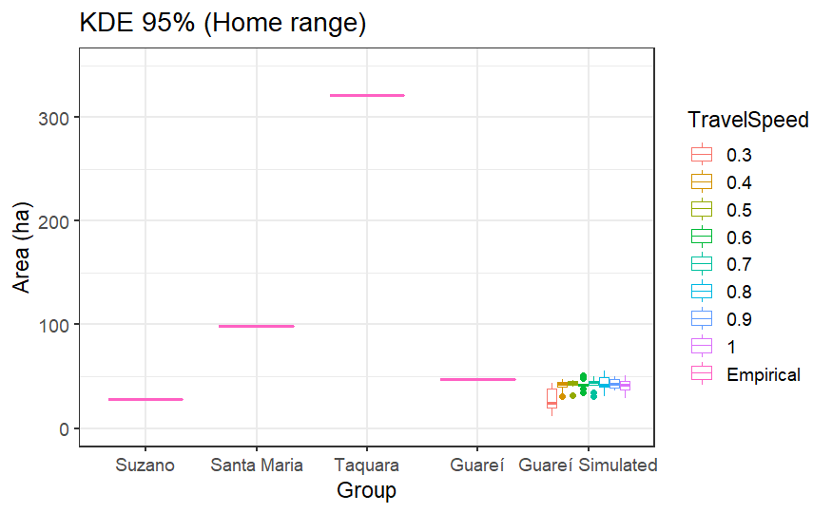
4) MODEL VALIDATION
Model v1 2022:
Home range

Slide 38
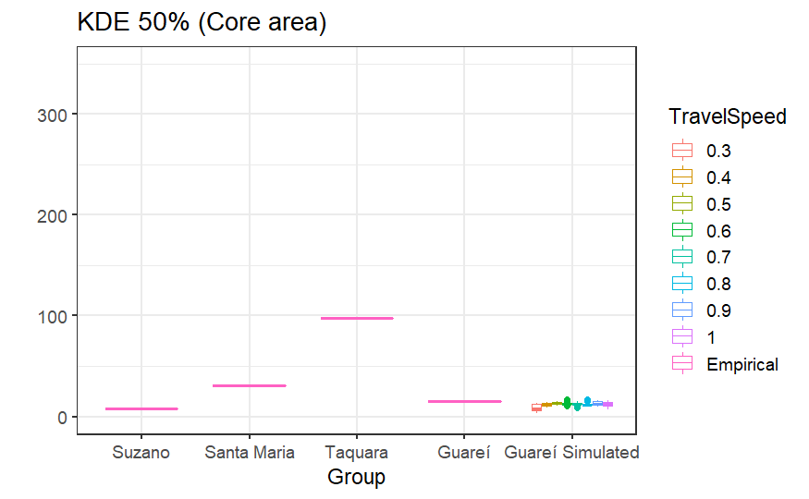
4) MODEL VALIDATION
Model v1 2022:
Home range
1) Home range ✓

Slide 39
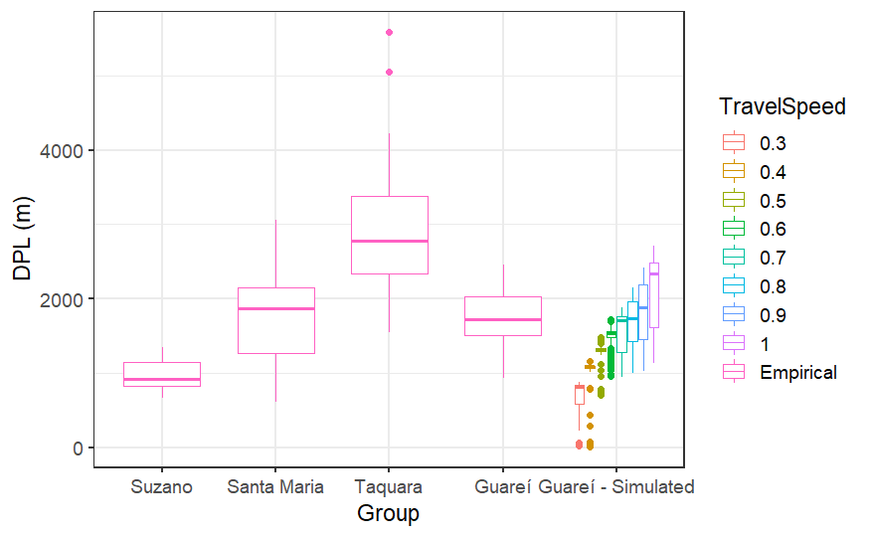
4) MODEL VALIDATION
Model v1 2022:
Daily Path Lenght

Slide 40
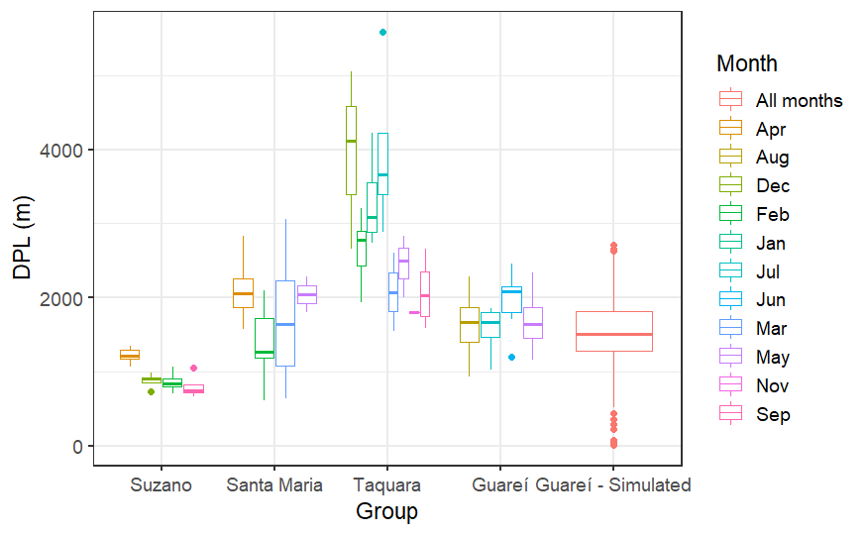
4) MODEL VALIDATION
Model v1 2022:
Daily Path Lenght
1) Home range ✓
2) DPL ✓ ?

Slide 41
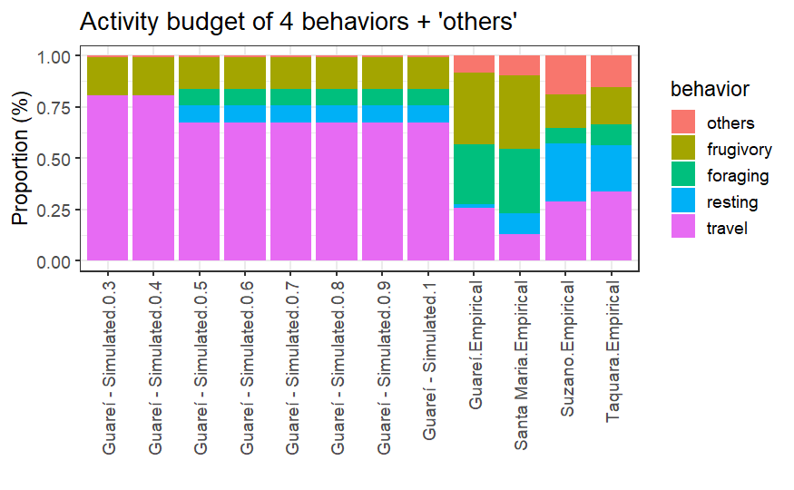
4) MODEL VALIDATION
Model v1 2022:
Activity Budget

Slide 42
4) MODEL VALIDATION
Model v1 2022:
Activity Budget
Tamarins are travelling too much in the model

Slide 43
4) MODEL VALIDATION
Model v1 2022:
Activity Budget
Tamarins are travelling too much in the model
1) Home range ✓
2) DPL x
3) Activity Budget x

Slide 44
4) MODEL VALIDATION
Model v1 2022:
Seed Dispersal Distance
(coming soon)
1) Home range ✓
2) DPL x
3) Activity Budget ✓ ?
4) SDD ?

Slide 45
4) MODEL VALIDATION
Model v1 2022:
Seed Dispersal Distance
(coming soon)
1) Home range ✓
2) DPL x
3) Activity Budget ✓ ?
4) SDD ?
(A little better than the oldest version)

Slide 46
4) MODEL VALIDATION
Model v1 2022:
Seed Dispersal Distance
(coming soon)
1) Home range ✓
2) DPL x
3) Activity Budget ✓ ?
4) SDD ?
Still needs parameterization and calibration
(A little better than the oldest version)

Slide 47
4) MODEL VALIDATION
Model v1 2022:
Step lenght
(coming soon)

Slide 48
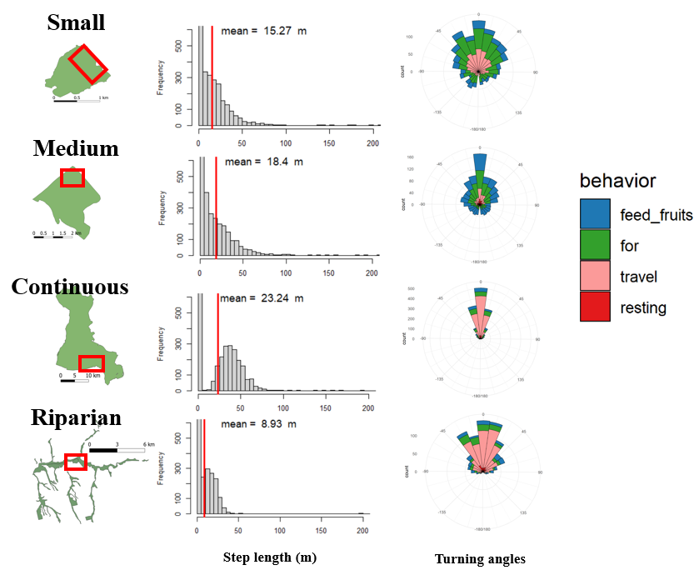
4) MODEL VALIDATION
Model v1 2022:
Step lenght
(coming soon)

Slide 49
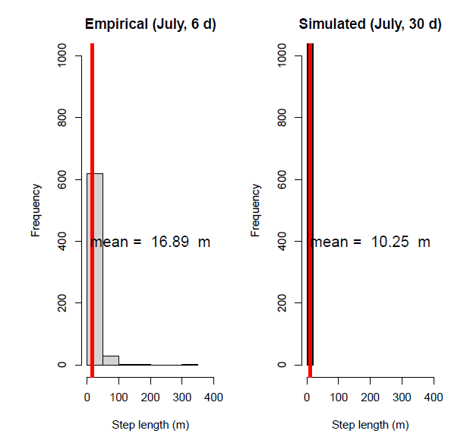
4) MODEL VALIDATION
Model v1 2022:
Step lenght
(coming soon)

Slide 50
4) MODEL VALIDATION
Model v1 2022:
Turning angles
(coming soon)

Slide 51
4) MODEL VALIDATION
Model v1 2022:
Turning angles
(coming soon)

Slide 52
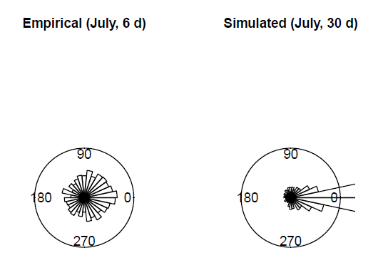
4) MODEL VALIDATION
Model v1 2022:
Turning angles
(coming soon)

Slide 53
4) MODEL VALIDATION
Multi pattern validation:
1) Home range size
2) Daily Path Length (DPL)
3) Activity Budget
4) Seed Dispersal Distance (SDD)
Small patch
(100 ha) - Guareí
Home range:
~48 ha
Continuous forest
Implementation hypothesis:
1) Step length + turning angles
2) Resource distributions
3) Territoriality
Taquara (PEMD)
Home range:
~400 ha
Riparian forest
Suzano
Home range:
~25 ha

Slide 54
5) SCENARIO SIMULATION

Slide 55
5) SCENARIO SIMULATION
Hypothesis 1:
Hypothesis 2:
Hypothesis 3:
Patch size enhances black lion tamarins seed shadows (SDD)
Linear patch shapes enhance SDD, but enhances seed aggregation levels (negative effect)
High resource aggregation results in smaller SDD
SDD (m)
Fragment size (ha)
Fragment shape (SI)
High
Random
Low
Clumpedness degree

Slide 56
6) OUTLOOK (NEXT STEPS)

Slide 57
6) OUTLOOK (NEXT STEPS)
How to iterate through areas without heavy reparameterization?
Step lenght + turning angles should emerge from the model, and not be parameterization (Ranc et al 2022)

Slide 58
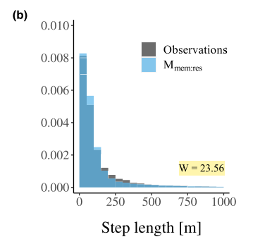
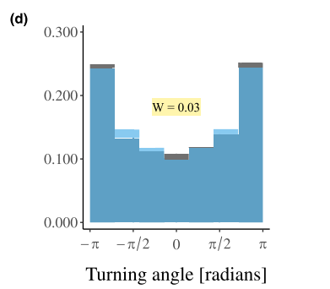
6) OUTLOOK (NEXT STEPS)
How to iterate through areas without heavy reparameterization?
Step lenght + turning angles should emerge from the model, and not be parameterization (Ranc et al 2022)

Slide 59
6) OUTLOOK (NEXT STEPS)
How to iterate through areas without heavy reparameterization?
Step lenght + turning angles should emerge from the model, and not be parameterization (Ranc et al 2022)
The same is valid for resource revisitation and activity budget

Slide 60
6) OUTLOOK (NEXT STEPS)
How to iterate through areas without heavy reparameterization?
Step lenght + turning angles should emerge from the model, and not be parameterization (Ranc et al 2022)
The same is valid for resource revisitation and activity budget
Need of a movement model that is more related to territoriality (area) and less dependent on trees (points)

Slide 61
6) OUTLOOK (NEXT STEPS)
How to iterate through areas without heavy reparameterization?
Step lenght + turning angles should emerge from the model, and not be parameterization (Ranc et al 2022)
The same is valid for resource revisitation and activity budget
Need of a movement model that is more related to territoriality (area) and less dependent on trees (points)
The v1 model will still be subjected to calibration and sensitivity

Slide 62




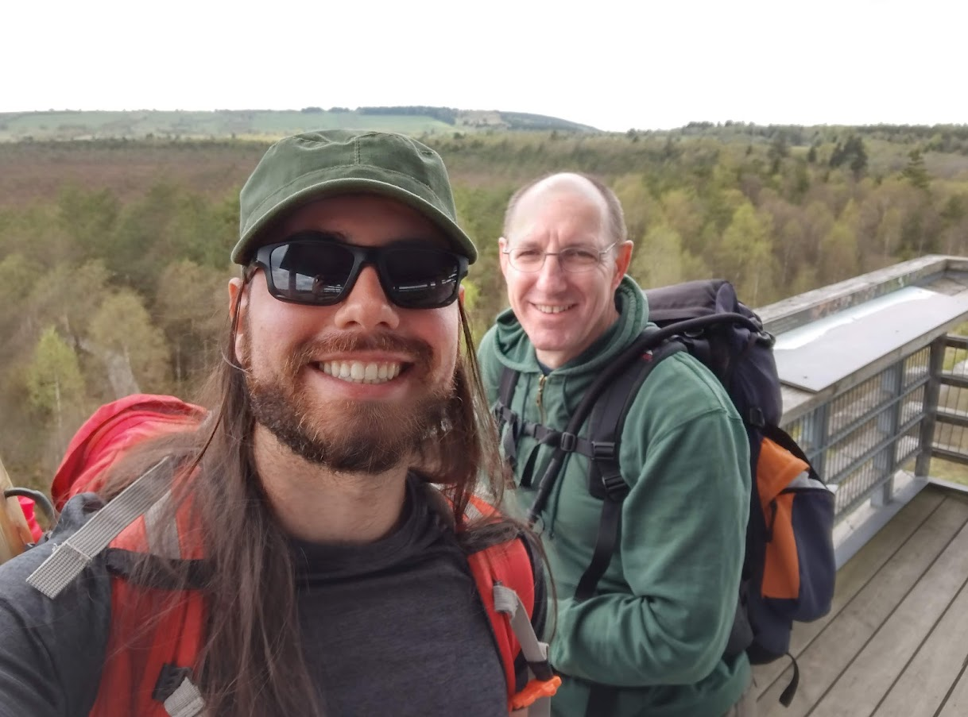
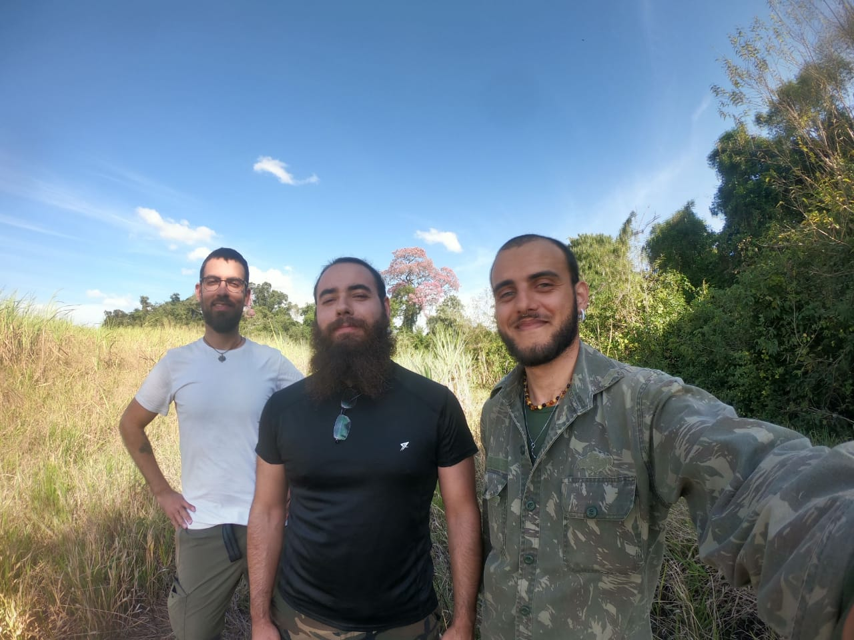
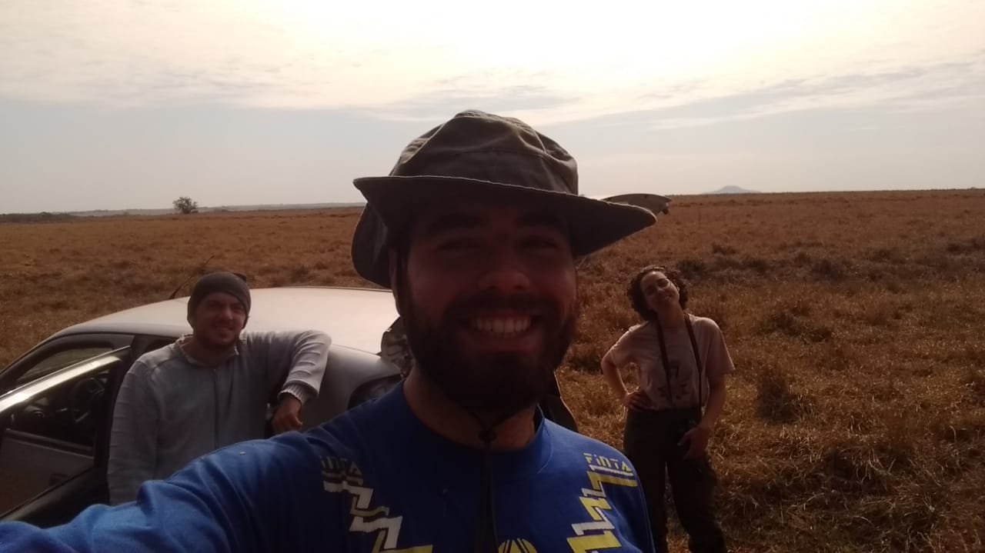

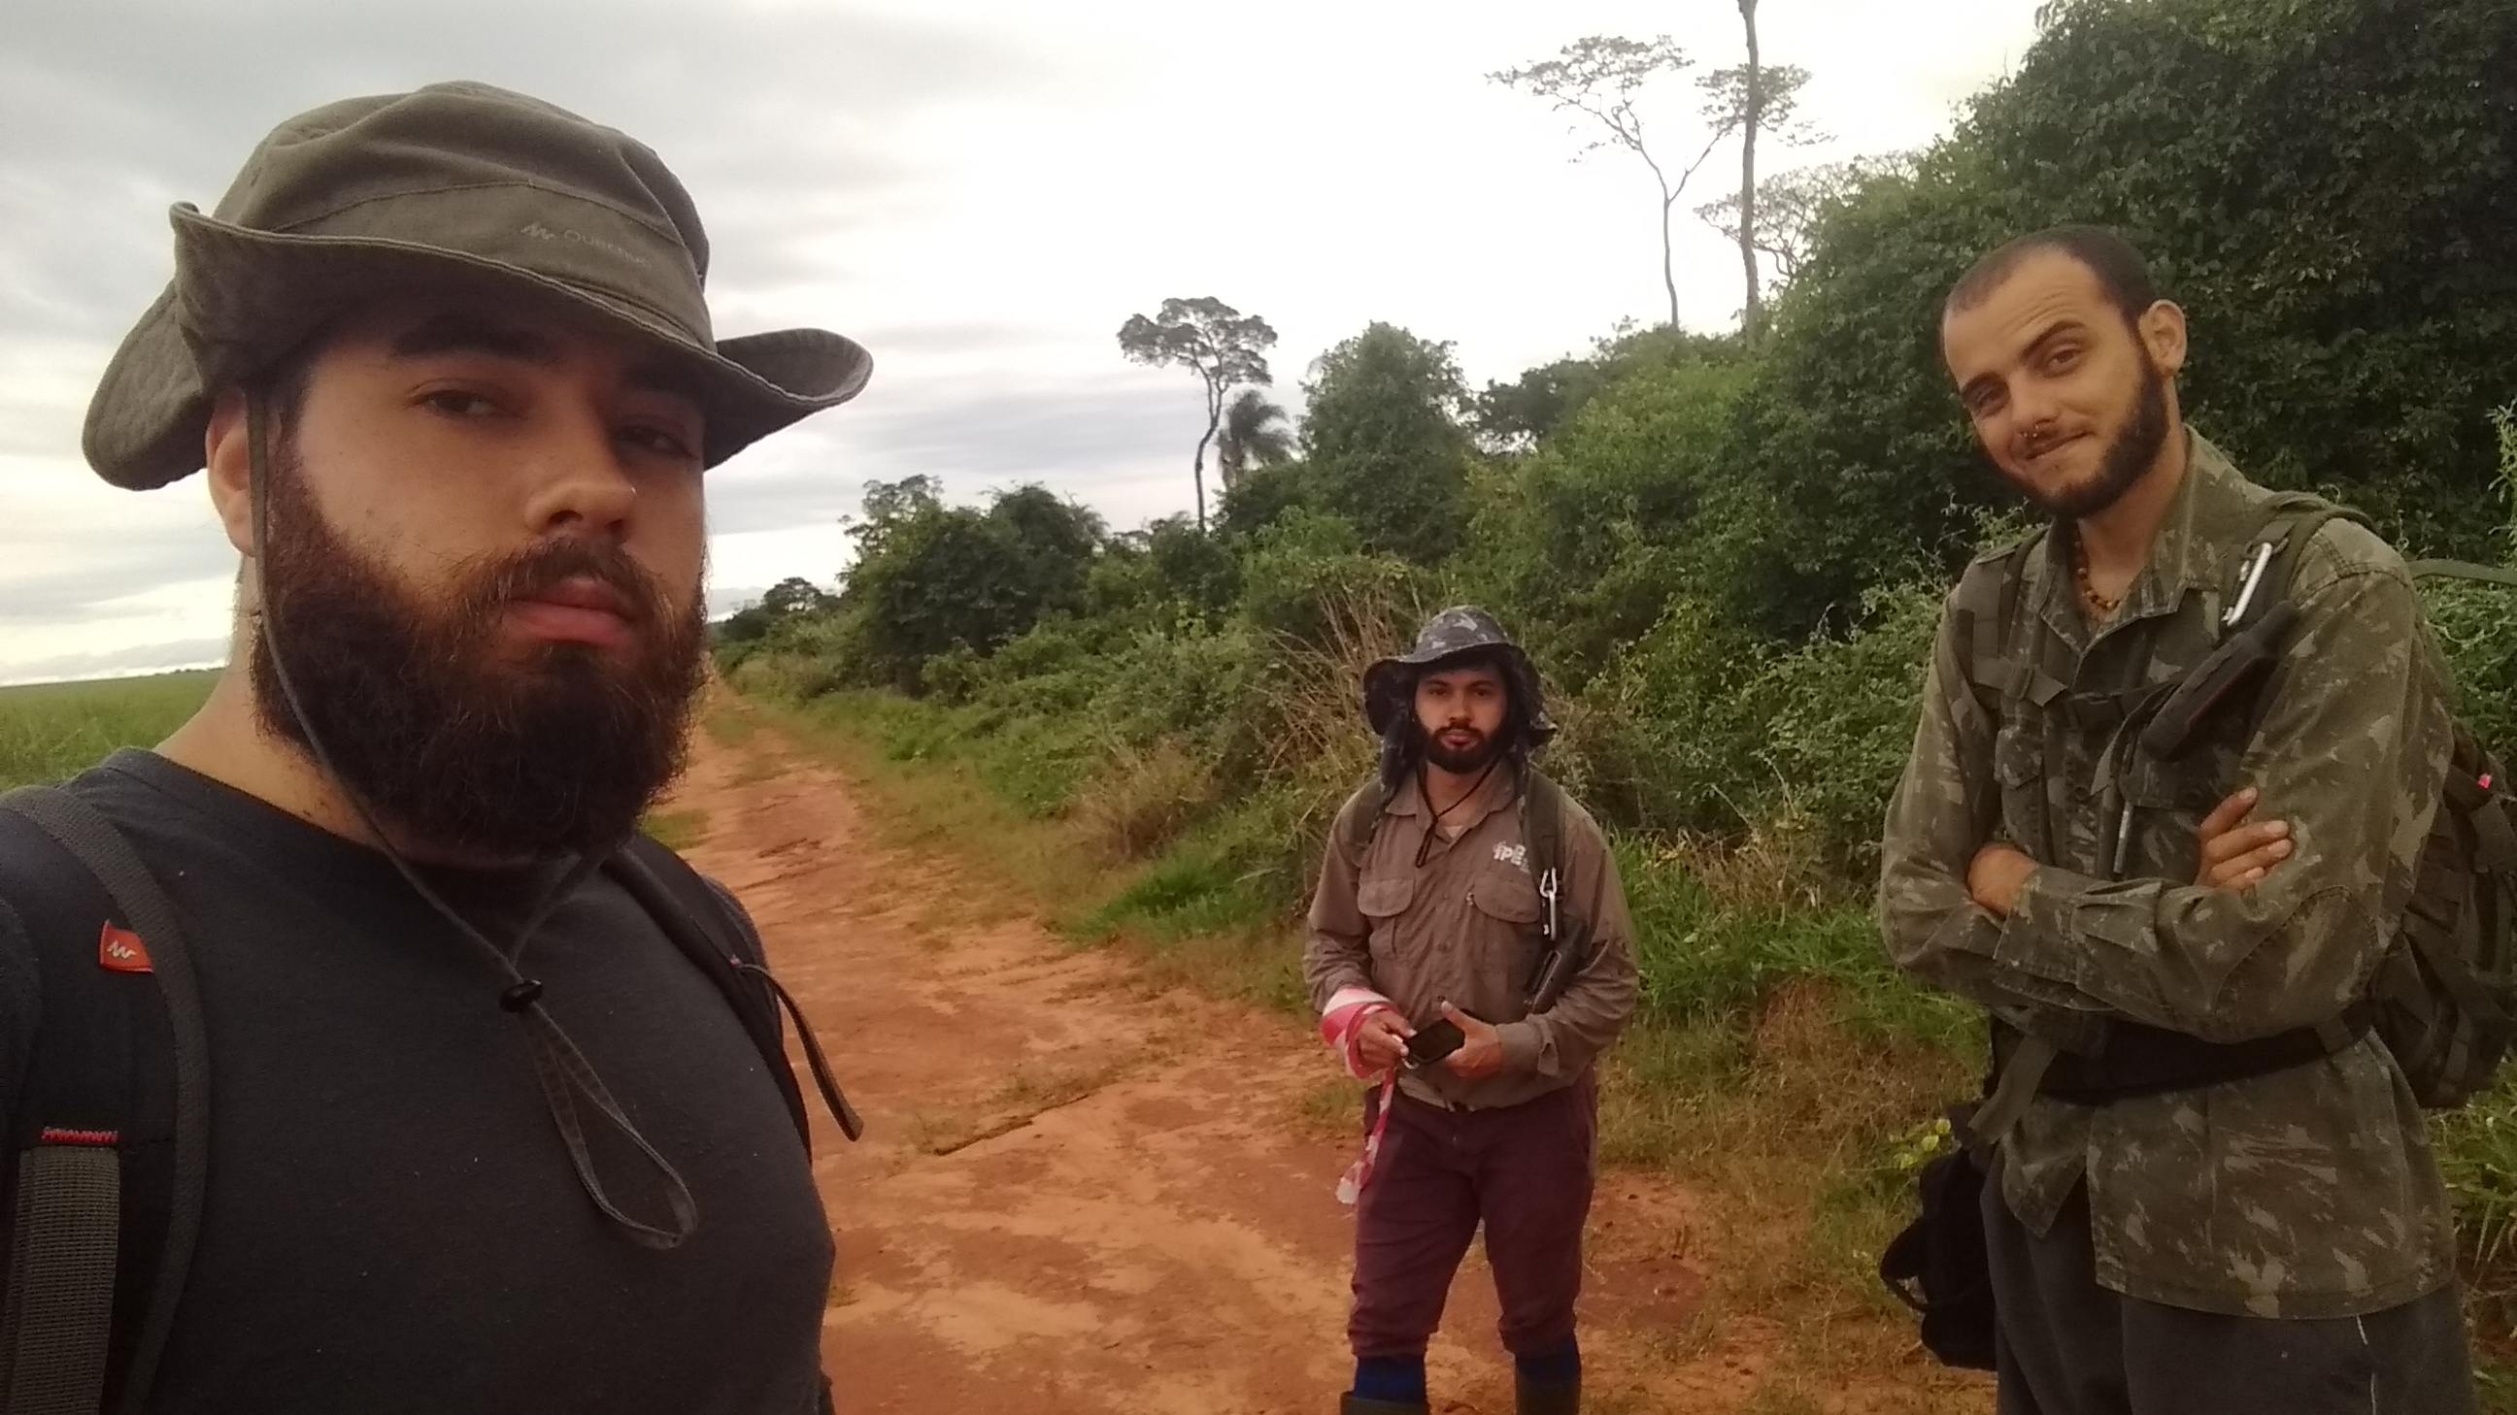

ACKNOWLEDGEMENTS
Obrigado!
Eco Mod Seminar
Sebastian Hanß
Eyal Goldstein
Eduardo Miguel Zanette
duhmzc@gmail.com
@edmizac
LaP website:
https://primatology.wixsite.com/unesp-lap

Slide 63
EXCERPTS

Slide 64
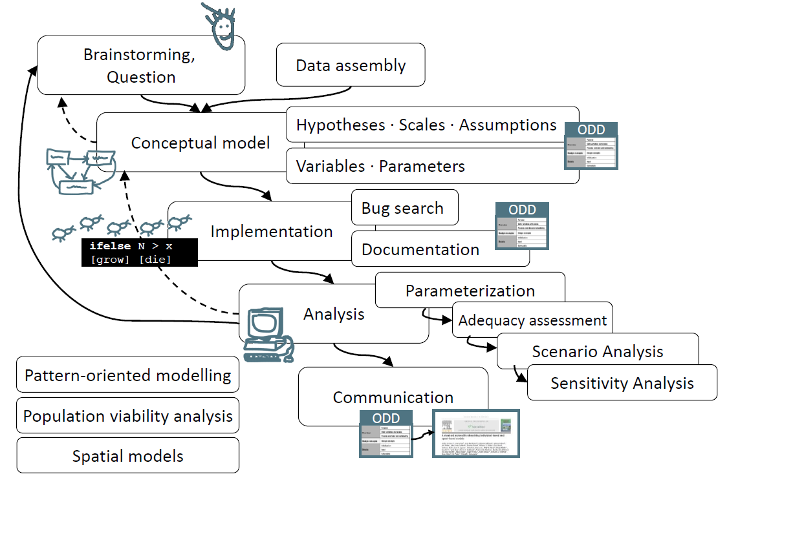

Slide 65
What are the effects of forest patch size and shape on primate movement patterns?
1 = linear patterns
0 = circular patterns
*No work testing the effect of patch shape on primate movements
Inconsistent effect
No relation to species attributes (dispersal capacity, home range size, diet specialization, etc)
Tendency towards circular movements in smaller fragments (Chiropotes satanas)
Modified from Carretero-Pinzón et al. (2016)
Modified from Boyle et al. (2009)

Slide 66
What is the effects of resource distribution on primate movement patterns?
Larger trees (high DBH) are more intensily gouged
Gouging trees more agreggated than expected by chance
Thompson et al. (2013) IJP

Slide 67
What is the effects of resource distribution on primate movement patterns?
Alouatta palliata aims for close places with higher fruit availbility (estimated by tree DBH)
Larger trees (high DBH) are more intensily gouged
Gouging trees more agreggated than expected by chance
Thompson et al. (2013) IJP
Hopkins (2016) Anim. Cog.

Slide 68
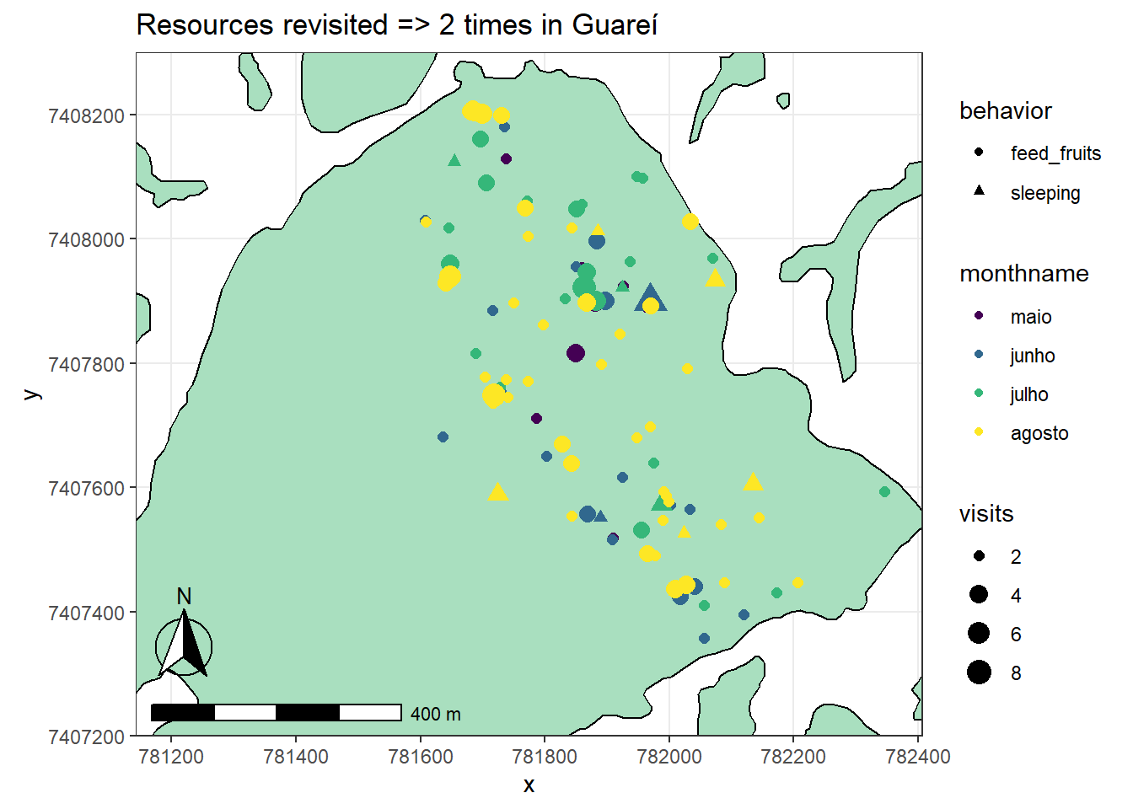
Model v1 2022:
Resource revisitation
(coming soon)

